Slide 1


Slide 2

<WELCOME >
<Sequences>

Slide 3

Sequences represent ordered lists of elements.
1, 3, 5, 7, 9, …
-1, 1, -1, 1, -1, …
2, 5, 10, 17, 26, …
0.25, 0.5, 0.75, 1, 1.25 …
3, 9, 27, 81, 243, …
Notation:
A = {3, 5, 7, ...}

Slide 4
Strings
Finite sequences are also called strings, denoted by a₁a₂a₃…a_{n}.
The length of a string S is the number of terms that it consists of.
The empty string contains no terms at all. It has length zero.

Slide 5
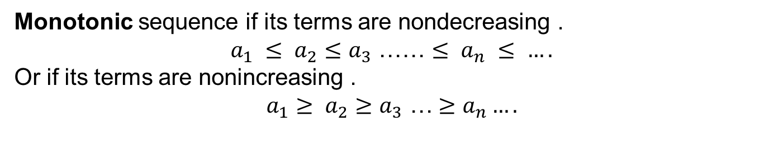
Sequences classification
Finite Sequence has a fixed number of terms.
A = {2, 4, 6, 8}
A sequence that has infinitely many terms is called an infinite sequence.
A = {2, 4, 6, 8,…}
Monotonic sequence if its terms are nondecreasing .
$a_{1} ≤ a_{2}≤a_{3}$ …… $≤ a_{n} ≤ ….$
Or if its terms are nonincreasing .
$a_{1}$ $≥ a_{2}≥a_{3}$ …$≥a_{n}….$

Slide 6
What do we want to know about sequences:
What is the N element? (without calculate every element)
How many elements the sequence has?
Evaluate the summation of the sequence
Evaluate the product of a sequence
Is the sequence converge to a finite value or not ?

Slide 7
We use the notation a_{n} to denote the element represented by integer n. We call a_{n} a term of the sequence.
1, 3, 5, 7, 9, …
a_{n} = 2n - 1
-1, 1, -1, 1, -1, …
a_{n} = (-1)^{n}
2, 5, 10, 17, 26, …
a_{n} = n² + 1
0.25, 0.5, 0.75, 1, 1.25 …
a_{n} = 0.25n
3, 9, 27, 81, 243, …
a_{n} = 3^{n}

Slide 8
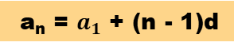
Arithmetic progression
Explicit formula for arithmetic sequence:
a_{n} = $a_{1}$ + (n - 1)d
Common
difference
First term
Recursive formula for an arithmetic sequence:
a₁ = #
a_{n} = a_{n-1} + d

Slide 9
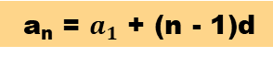
Example: 5, 2, -1, -4, …
a_{n} = $a_{1}$ + (n - 1)d
Explicit Formula Substitute the values:
a_{n} = 5 + (n – 1)(- 3)
Explicit formula is: a_{n} = -3n + 8
The Recursive Formula is:
a1 = 5
a_{n} = a_{n -1} – 3

Slide 10
Example: 5, 2, -1, -4, …
a_{n} = $a_{1}$ + (n - 1)d
Explicit Formula Substitute the values:
a_{n} = 5 + (n – 1)(- 3)
Explicit formula is: a_{n} = -3n + 8
The Recursive Formula is:
a1 = 5
a_{n} = a_{n -1} – 3

Slide 11
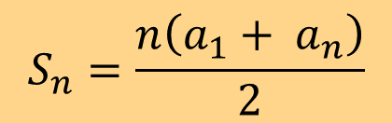
Summation
Example: 5, 2, -1, -4, …
The sum of the first n terms of a series…denoted $S_{n}$
First term
Last term
Number of terms
$$S_{n}=\frac{n\left(a_{1}+ a_{n}\right)}{2}$$
#2

Slide 12
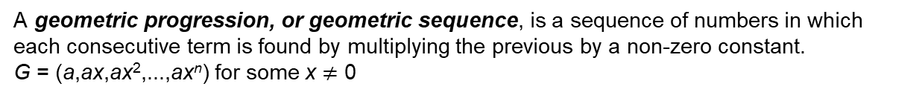
Geometric progression
A geometric progression, or geometric sequence, is a sequence of numbers in which each consecutive term is found by multiplying the previous by a non-zero constant.
G = (a,ax,ax²,...,ax^{n}) for some x $≠$ 0
A sequence is geometric if the ratios of consecutive terms are the same.

Slide 13
Geometric progression
Example : 3, 9, 27
Common
ratio
a_{n} = a₁r^{n – 1}
First term
The sum of the first n terms of a geometric series is denoted as $S_{n}$
First term
Number of terms
#39
Common
ratio

Slide 14
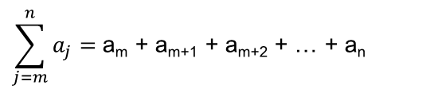
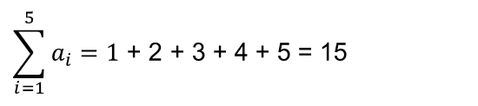
Summations
Fall 2002
CMSC 203 - Discrete Structures
$$\sum_{j=m}^{n}{a_{j}=\text{a}\text{m}\text{ + }\text{am}\text{+1 +} \text{am}\text{+2 +}\text{ … + }\text{an} }$$
The variable j is called the index of summation, running from its lower limit m to its upper limit n. We could as well have used any other letter to denote this index. For example:
$$\sum_{i=1}^{5}{a_{i}=\text{1}\text{ + }\text{2}\text{ + }\text{3}\text{ + }\text{4 +} \text{5} \text{= 15}}$$

Slide 15
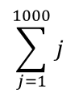
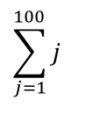
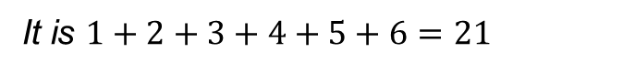
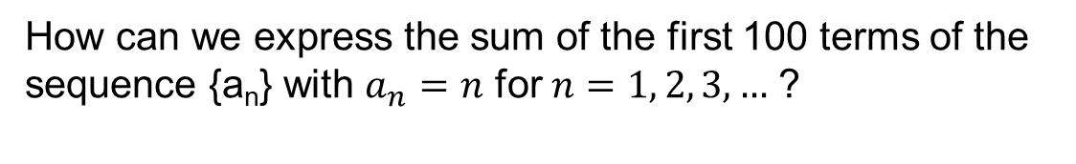
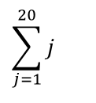
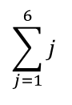
Summations
Fall 2002
CMSC 203 - Discrete Structures
How can we express the sum of the first 100 terms of the sequence {a_{n}} with $a_{n}=n$ for$n=1, 2, 3,…$ ?
$$\sum_{j=1}^{1000}{j}$$
We write it as
$$\sum_{j=1}^{6}{j}$$
What is the value of ?
It is $1+2+3+4+5+6=21$
$$\sum_{j=1}^{20}{j}$$
$$\sum_{j=1}^{100}{j}$$
What is the value of or ?
That’s a lot of work.

Slide 16

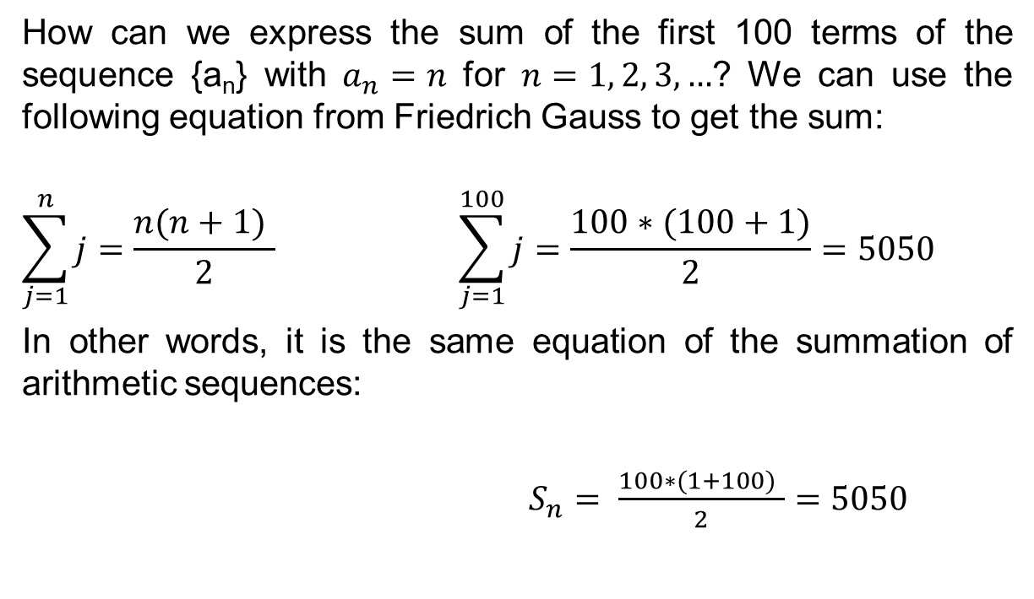
Summations
Fall 2002
CMSC 203 - Discrete Structures
How can we express the sum of the first 100 terms of the sequence {a_{n}} with $a_{n}=n$ for $n=1, 2, 3,…$? We can use the following equation from Friedrich Gauss to get the sum:
$$\sum_{j=1}^{n}{j}=\frac{n(n+1) }{2} \sum_{j=1}^{100}{j}=\frac{100∗(100+1)}{2}=5050$$
In other words, it is the same equation of the summation of arithmetic sequences:
$S_{n}= \frac{100∗(1+100) }{2}=5050$
$$S_{n}=\frac{n\left(a_{1}+ a_{n}\right)}{2}$$

Slide 17
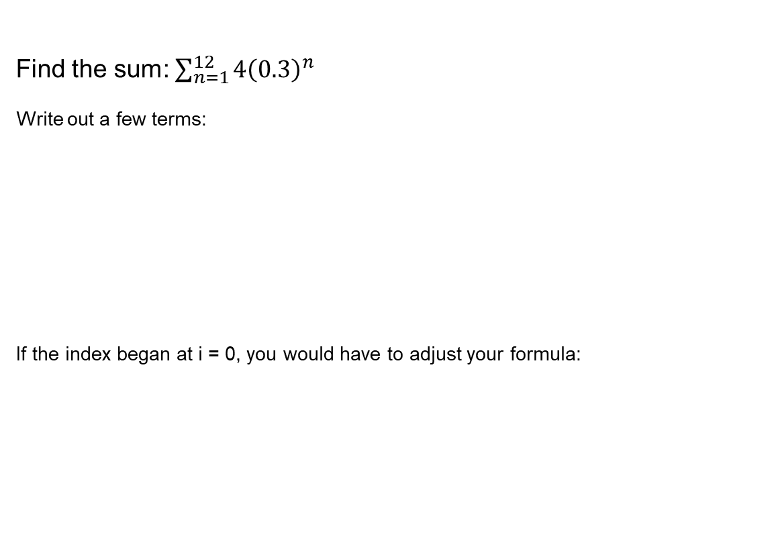
Fall 2002
CMSC 203 - Discrete Structures
Find the sum: $\sum_{n=1}^{12}{4{\left(0.3\right)}^{n}}$
Write out a few terms:
If the index began at i = 0, you would have to adjust your formula:

Slide 18
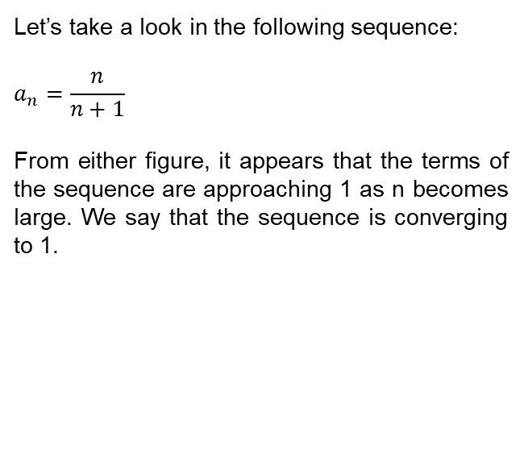
Convergence
Let’s take a look in the following sequence:
$$a_{n}=\frac{n}{n+1}$$
From either figure, it appears that the terms of the sequence are approaching 1 as n becomes large. We say that the sequence is converging to 1.

Slide 19
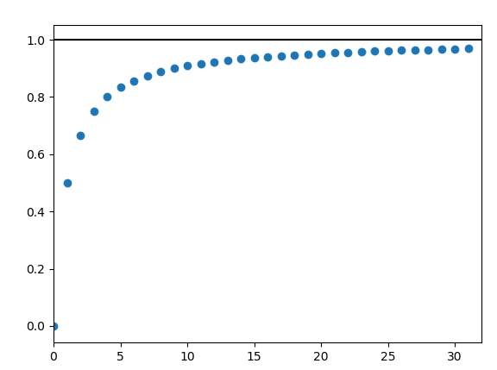
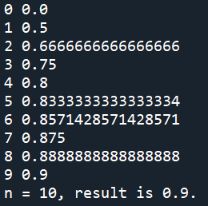
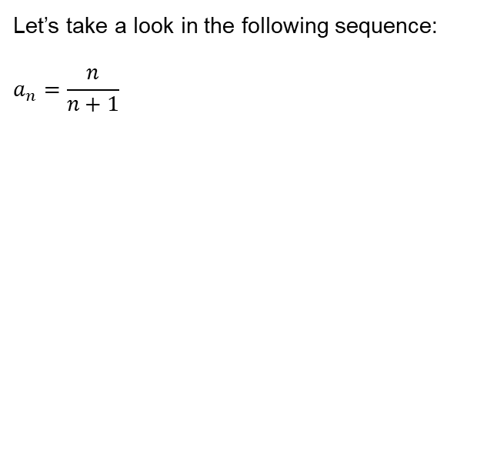
Convergence
import matplotlib.pyplot as plt
x = 1.0
n = 50
data = []
for i in range(n):
x1 = i/(i + 1)
if abs(x1 - x) < 1.e-2:
print('n = {i}, result is {x}.'.format(i=i, x=x))
last_index = i
break
x = x1
data.append([i,x])
print(i, x)
else:
print('No convergence within {n} iterations.'.format(n=n))
last_index = n
plt.scatter(*zip(*data))
plt.hlines(y=1,xmin=0,xmax=last_index)
plt.xlim(0, last_index)
Let’s take a look in the following sequence:
$$a_{n}=\frac{n}{n+1}$$

Slide 20
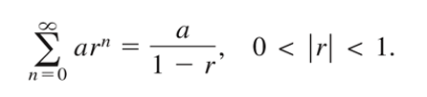
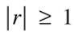
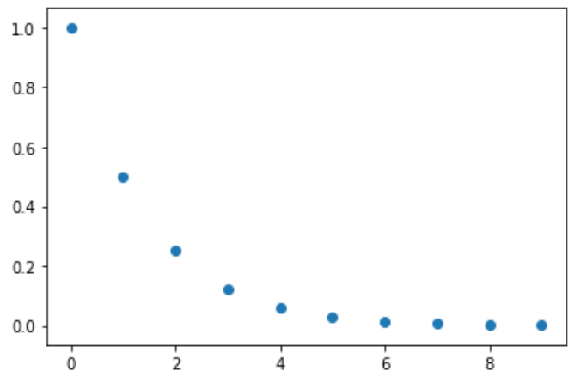
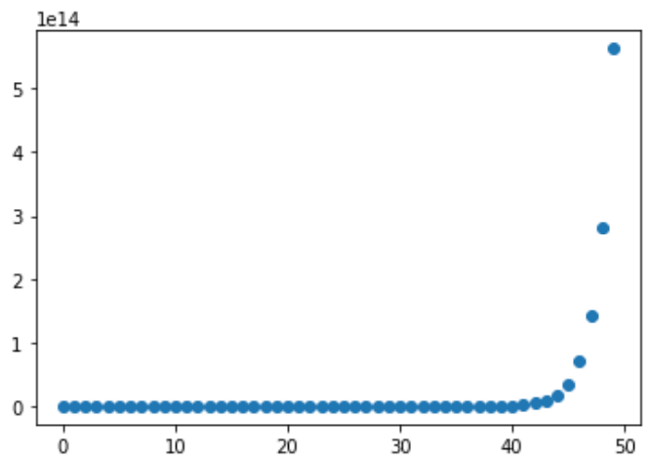
Sequences Exercise
import matplotlib.pyplot as plt
x = 0
n = 50
data = []
for i in range(n):
x1 = 0.5**i
print(i, x)
if abs(x1 - x) < 1.e-3:
print('n = {i}, result is {x}.'.format(i=i, x=x))
last_index = i
break
x = x1
data.append([i,x])
else:
print('No convergence within {n} iterations.'.format(n=n))
last_index = n
plt.scatter(*zip(*data))
It is possible to have for and else connected.
Check more information on the link below
Check if the sequence converges using python:
r = 0.5
r = 2
List of lists
Plotting list of lists
Converge to 0 when
https://book.pythontips.com/en/latest/for_-_else.html

Slide 21
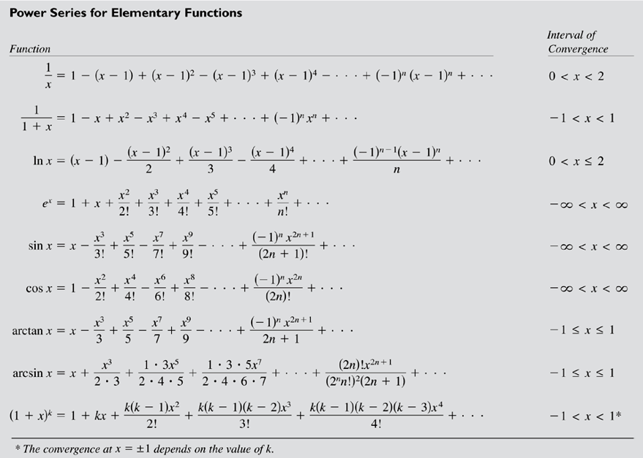
Approximations using series

Slide 22
Make it work
Make it Right
Make it Fast

Slide 23


